Slide 1

Data Science in Practice
US Accidents – Predictive Modelling and EDA
Roupyajay Bhattacharya , IISc., roupyajayb@iisc.ac.in
Umesh BP, IISc., umeshbp@iisc.ac.in
Madipally Bhagath Chandra, IISc.,bhagathchan1@iisc.ac.in
Ninad Phadnis, IISc., ninadphadnis@iisc.ac.in

Slide 2
Problem Statement
Problem Definition:
  The project is to use data science tools and techniques to build predictive modelling for a countrywide car accident dataset that covers 49 states of the USA. The accident data was collected from February 2016 to March 2023. The severity is the target variable, and it indicates the length of the traffic (Higher severity means more traffic)
Problem Motivation:
  Road accidents are a safety concern and can be life threatening or lead to permanent disability. A right analysis can help the police authorities to rightly allocate their resources, the government to plan some specific infrastructural opportunities and bring some regulatory changes. It can also help other stakeholders like business hubs to make specific changes to further help in ensuring employee safety as is further inferred in our report.
Project Scope:
  We have focused on two main topics following the basic data cleaning and data preparation. First, we conducted exploratory data analysis to find various patterns in the data and check relationships between various attributes of the data using univariate, bivariate, and multivariate analysis.
Project Objective: Predict accident severity using weather, infrastructure, and temporal features.

Slide 3
Data Overview
The source of the data is from Kaggle: US Accidents (2016 - 2023). The data has 7728394 unique values i.e. circa 7.7M values. The data is rich with a wide range of data point spanning across multiple areas as below:
Weather data: Captures temperature, humidity, pressure, Visibility, Wind Speed etc.
Severity, Source: Accident severity level and data source
Infrastructure / road data: Roundabout, Bump, Crossing, Railway, Traffic signals, Junctions, Nearby airport etc.
Location data: Address, Pin code, County, City.
Time data: The date of the accident is captured in YYYY-MM-DD along with the time of the day in HH:MM:SS.
The data also has a few missing columns like End Latitude and End Longitude amongst others.

Slide 4
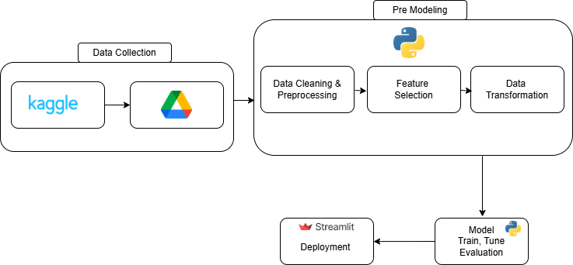
Architecture Diagram

Slide 5
Data Preparation and Cleaning
Identification of null values and appropriately treating them.
  Removed null values that have occurred majority of times.
  Null values in columns like Zipcode were treated with the zipcode nearest to the latitude and longitude coordinates,
Preprocessing of "Start_Time" column.
  The preprocessing of this column helped perform bivariate and multivariate analysis for the accidents with respect to the time of the day and the appropriate weekday. Refer code as below:
A set of rows after 01-01-2020 were selected to reduce the computational effort for running the code. The data challenges will be addressed at the end.
Data Leakage: We removed columns that constitute 100% of the data.

Slide 6
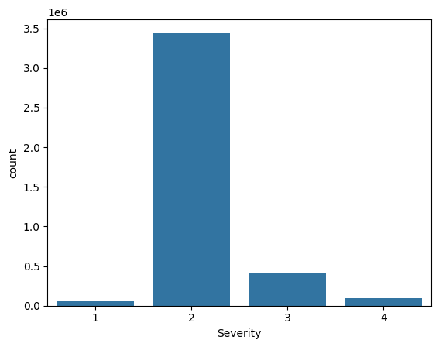
Data Exploration
EDA - General
A set of different EDA techniques were deployed to analyze the data.
Univariate analysis: Performed on the "Severity column"
Insights: Imbalanced data. Severity 2 dominates

Slide 7
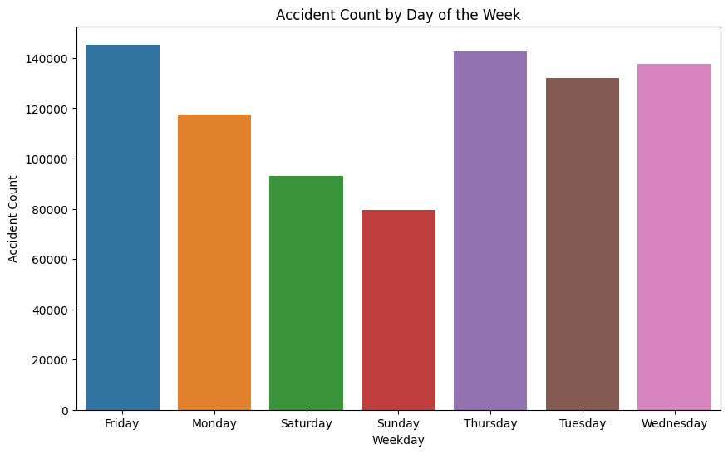
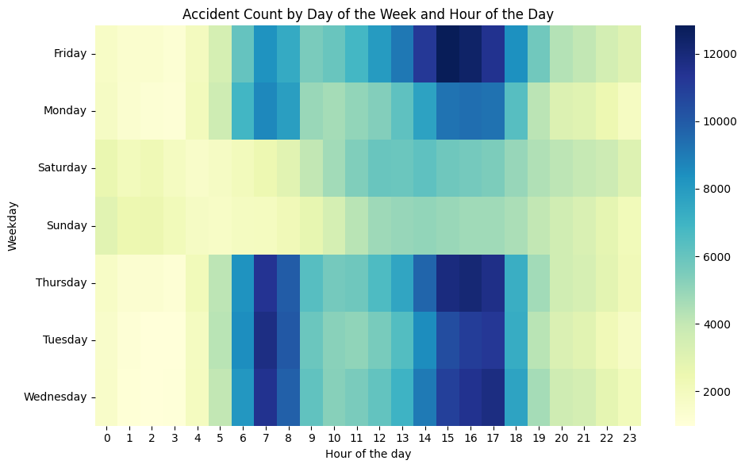
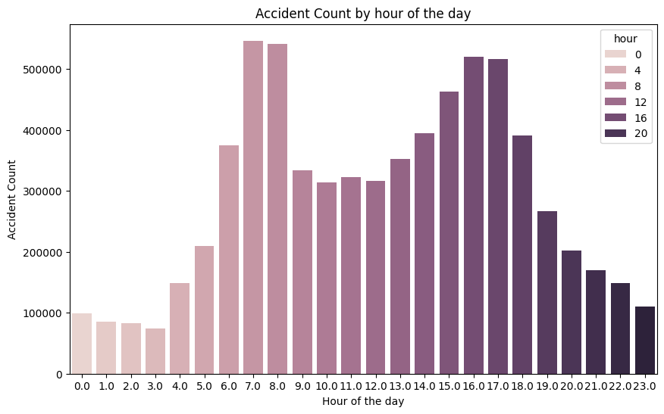
Data Exploration
EDA - Multi-variate Analysis
The data indicates that accident frequencies cluster on weekdays, with pronounced spikes in the morning and evening, coinciding with office commute periods.

Slide 8
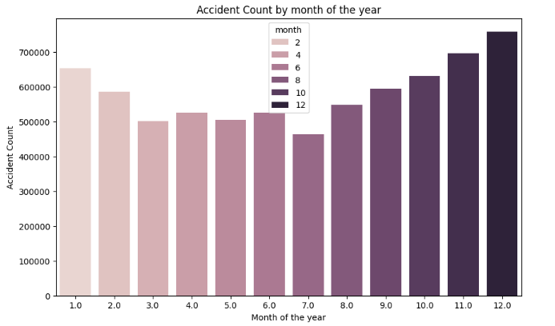
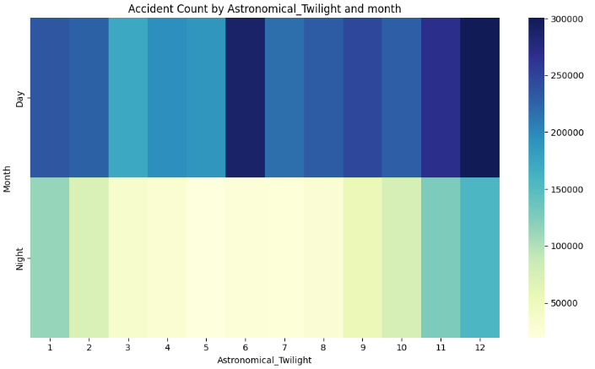
Data Exploration
EDA – By season
Number of accidents peak during the winter months. This is consistent with our feature classification that shows that the month has a significant contribution to the occurrence of accidents.

Slide 9
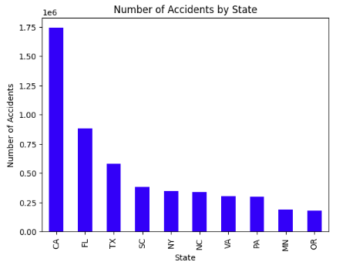
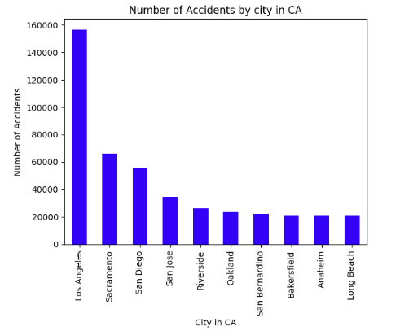
EDA – By cities and states

Slide 10
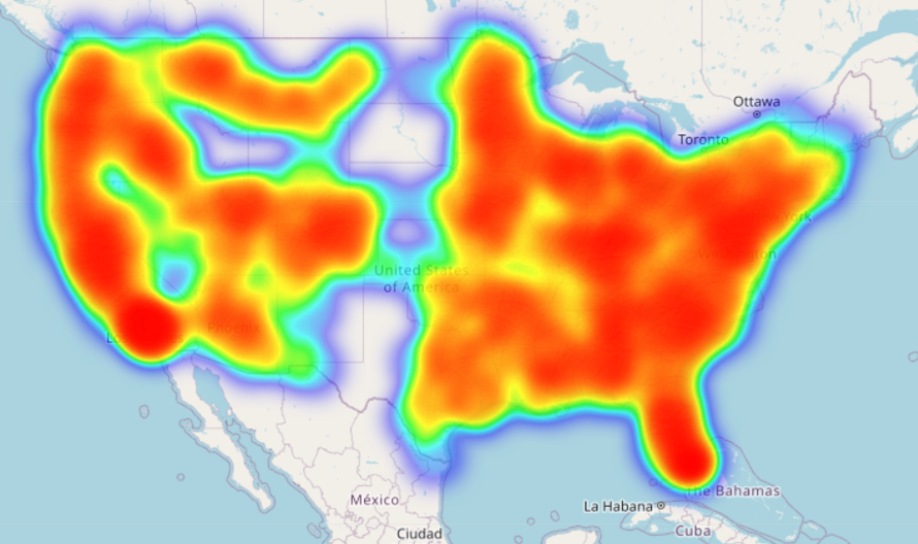
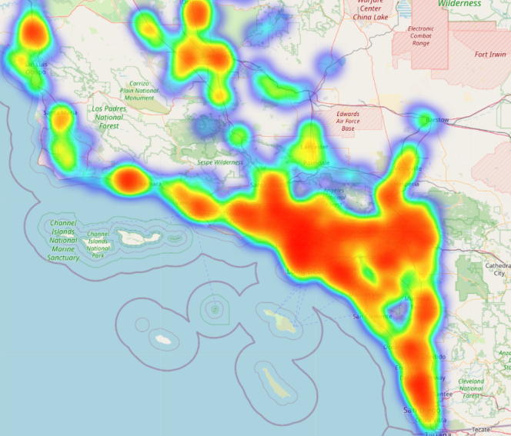
HeatMap
  HeatMap can be used to understand the dense regions with high accident probability.
  It is an interactive way of checking across the country / county / state to find most common accident hotspots which can be used to by authorities to deploy the right resources like police personnel or add safety protocols in the region.
A further drill down into a specific zone of California is shown below for reference.

Slide 11
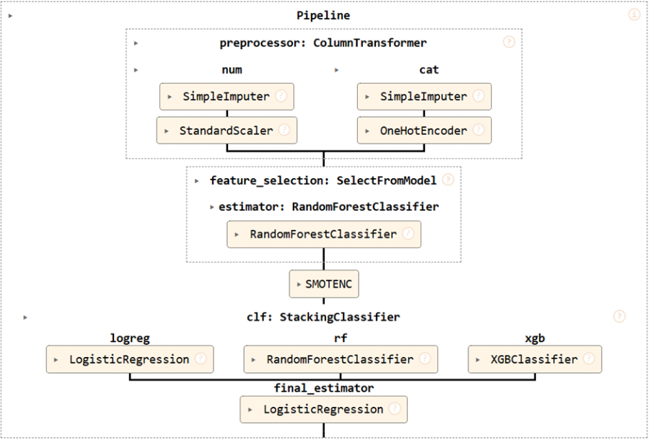
Data Modelling
Target Variable selection:
Severity with 4 classes (1,2 3,4)
Feature Engineering:
Feature Selection: We have used the random forest feature selection based on the feature importance of each feature metric.
Feature transformation: We've applied multiple types of transformation across various types of features as per below:
Numerical features: Applied standard scaler (for features like Temperature, Pressure, Wind Speed etc.)
Boolean features: Converted to numbers (1/0) (for features like Bump, Stop, Amenity etc.) (Binary label encoding)
Categorical Features: One hot encoding (for features like (Wind Direction, weather condition etc.)
Additon of new features like Month, Days of Week, Season etc.
Other Transformations: Applied date filters to remove some historical observation.
Train vs Validation vs Test split:
Applied train (Jan 2020 to Dec 2021) vs Validation (Jan 2022 to Dec 2022) vs Test (Jan 2023 to Mar 2023)
Model Selection:
Ensemble Model combining the following:
Logistic regression
Random Forest
XGBoosting
Final estimator: Multi-nominal logistic regression to get the contribution from each feature.
Model Tuning:
Used stratified cross validation / random search which include hyperparameters:
Feature selection threshold, Penalty, Final estimator solver
The key hyperparameters across models included:
Logistic regression: Solver, Maximum no of iterations
Random Forest: Max Depth, No. of estimators
XGBoosting: Max Depth, No. of estimators, Learning Rate
Model Output:
Probability of Severity
Class of Severity
Contribution from features towards severity

Slide 12
Model evaluation and Accuracy
Gradual improvements of accuracy:
With Only Logistic Regression: Test Accuracy: 35%, Validation accuracy: 30%
With Only Random Forest: Test Accuracy: 40%, Validation accuracy: 42%
With Only XGBoost: Test Accuracy: 50%, Validation accuracy: 50%
With Logistic Regression + Random Forest: Test Accuracy: 60%, Validation accuracy: 65%
With Logistic Regression + Random Forest + XGBoost : Test Accuracy: 89%, Validation accuracy: 84% (Final model): Train F1 score: 0.9309
Final Confusion Matrix:
Validation Matrix
 | Predicted
Actual | Class | 1 | 2 | 3 | 4
 | 1 | 8 | 889 | 71 | 18
 | 2 | 29 | 34811 | 2855 | 568
 | 3 | 4 | 947 | 93 | 24
 | 4 | 4 | 1107 | 101 | 32
Test Matrix
 | Predicted
Actual | Class | 1 | 2 | 3 | 4
 | 1 | 0 | 0 | 0 | 0
 | 2 | 6 | 11003 | 840 | 130
 | 3 | 0 | 0 | 0 | 0
 | 4 | 1 | 327 | 24 | 1

Slide 13
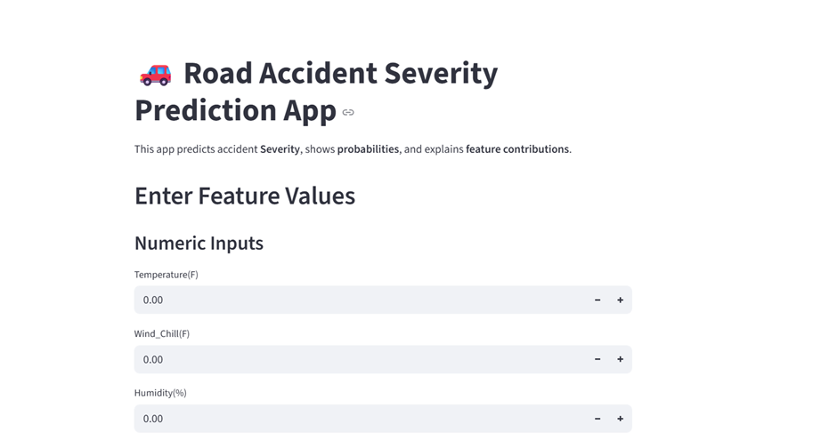
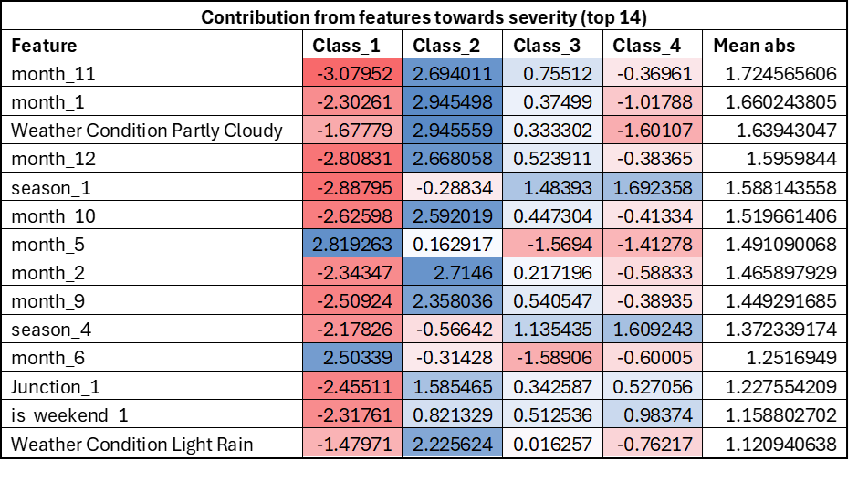
Demo: Model Deployment and Visualization of Results
Deployed the model in streamlit application
Sample Output
Link to app: https://ds-us-accidents-analysis-7xhebyb48xunkr4cn8zqhe.streamlit.app/

Slide 14
Business recommendations
Based on EDA:
Deploy more strict vigilance over the traffic during peak office commute hours. Morning 7am - 9am and evening 4pm - 6pm.
Offices can give flexibility for log in and log off to avoid the rush leading to accidents.
Clinics / ambulances can be deployed in vicinity of the red zones as per the heat map to optimized use of the healthcare services and ensuring quick treatments.
Based on Output (some top ones):
People should driver carefully during winter in month Nov, December, January.
If the weather condition is cloudy or partially cloudy cars should be monitored carefully.
The Road Junctions should be monitored carefully.
During sunrise or sunset time cars should be tracked carefully and should be give guidance.
In case there's no traffic signal severity is high to get an accident. So, try to install signals in most of the sensitive sections of roads.

Slide 15
Challenges & Future Possibilities
The data size is very huge (~3GB with 7.7M rows and 46 columns) and we faced frequent system crashing because of the RAM available in Google Colab. We used the chunking method as shown below to split the data in the size of 200000. Also shifted our model to VS Studio. Overall runtime was high because of big data size. We discarded some historical data points to reduce the data size and then to reduce the total runtime.
We observed a lot of class imbalance in the data with most accident severity scores of S2. We used the ‘smote’ approach along with Stratified sampling to handle this imbalance in the data. Refer: the below distribution of severity scores for data set after 01-JAN-2020.
Other issue we faced was regarding the mixed data types across all the 46 columns. These were either boolean in nature, categorical in objects. They were handled as per the specific requirement in the model.
Selection of model is also a challenge because of less accuracy. We eventually moved to an ensemble model to best the best accuracy. That increased the run time eventually.
Lack of Resource: Another challenge was we do not have access to cloud or some other platfrom to amange such a big size data. So, handling everything on local was a challenge.
Possible Future improvements:
A full version of app with full data sets.
Addition of more classes in target variable.

Slide 16
Data Science Canvas |  |  | Project: | US Accidents – Predictive Modelling and EDA
 |  |  | Team: | Roupyajay Bhattacharya, Umesh BP, Madipally Bhagath Chandra, Ninad Phadnis
Problem Statement |  |  |  | Execution & Evaluation |  | Data Collection & Preparation
Business Case & Value Added Which business case should be analyzed and what added value does it generate? Understand the impact of various factors on severity of accidents to reduce severity of accidents to save life . US Accidents – Predictive Modelling Offices can give flexibility for log in and log off to avoid the rush leading to accidents. Clinics / ambulances can be deployed in vicinity of the red zones as per the heat map to optimized use of the healthcare services and ensuring quick treatments. | Model Selection Which analysis methods can be considered on the basis of the specific data landscape and the business case? Ensemble of - Logistic Regression - XGBoost - Random Forest | Model Requirements Which model requirements must be complied with in order to obtain a valid model? Extensive Data Analysis must be performed to remove outliners & covariance among features. Need ML classification model like Logistic Regression, Decision Tree or Ensemble model like Random Forest to obtain a valid model . | Skills What skills are needed to provide the data and model development? - Data Science hands on learning. ​ Knowledge on data preprocessing & cleaning Knowledge on Explanatory Data Analysis ​ ​ Knowledge on model building and model validation​ ​ Knowledge on Python libraries​ ​ Knowledge in Google Collab​ ​ Knowledge on integration & reporting​ ​ | Model Evaluation Which indicators require quality control and validation and how should they be interpreted? Is real-time monitoring necessary? Parameters:​ Accuracy: To Measure overall correctness of predictions​ ​ Precision, Recall, F1-score: To Measure trade-off between false positives and false negatives​ ​ Confusion Matrix: to show classification breakdown per class​ ​ AUC / ROC: To Measures ability to separate classes​ ​ Cross-Validation (K-Fold): Reduces overfitting by testing model on multiple folds - Real time monitoring can be done. The data we have has been split into training and testing part and then the validation has been done. In the test data we can add more columns which will be part of the test which will help with the analysis. | Data Storytelling What requirements does the target group have for the presentation of the results and how do I effectively communicate this data? The data is split between training, validation and testing Business Stakeholders / Executives: ROI and strategic insights.​ ​ Data Scientists / Technical Teams: Model performance, metrics, algorithms, assumptions​ ​ Operations / Product Teams: Usability, integration, process improvements​ ​ End Users / Clients: Reliability, benefits, user experience​ ​ Regulators / Auditors: Fairness, transparency, compliance, data governance | Data Selection & Cleansing Which of the available data is relevant? Do the data have to be cleaned up? The available dataset from Kaggle website is relevant. The data is huge and was difficult to compute. So, the data has to be cleaned up and taken in chunks. necessary cleaning like handling missing values, removing unnecessary features, duplicates removal will be done. | Data Collection How and with which methods should additionally required data be collected? What properties has this data to fulfil? - Created some additional features like Month, Season, Day of Weeks from existing dataset only.
Data Landscape Which data is required for this and which is already available? Which additional data has to be collected? Need data which includes the features like Temperature, Wind Chill, Humidity(%),Pressure(in),Visibility(mi),Win Direction, WindSpeed(mph),Precipitation, Weather Condition, Amenity, Bump, Crossing etc. Mostly available in one dataset. Craeted some additional features like Month, Season |  | Software & Libraries Which software should be used? Is there already a standard solution? Which libraries are used? - Python, pandas, sklearn, matplotlib, seaborn, The results are showcased in streamlit dashboard |  |  |  | Data Integration In which system should the data from different sources be migrated? - VS Code & Google Drive as Colab need to be used because of high memory requirement. | Explorative Data Analysis Are there outliers or structures to be considered? Creation of descriptive key figures for the first assessment of the data. - There are no outliers. The EDA is present in the .ipynb file

